Slide 1
Websockets
Version 1
Amit Peled

Slide 2
Topics we’re going cover
HTTPS Protocol (before Websockets).
Websockets:
What is it and how it works.
What is the differences between Websockets and HTTPS.
Popular problems with Websockets and how we can solve them.
Websockets in our workshop – problems & solutions.

Slide 3
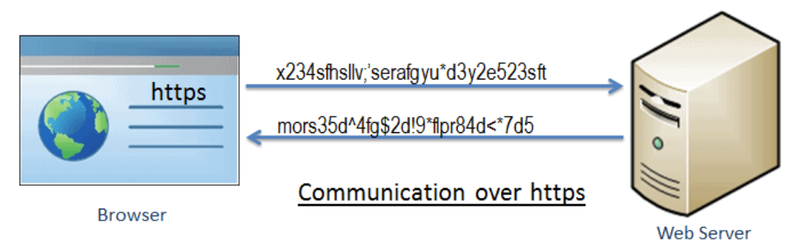
HTTPS Protocol
What is HTTPS protocol?
HTTPS = Hyper Text Transfer Protocol Secured
HTTPS is a protocol used for secure communication across the internet or a network.
HTTPS characteristics:
The data flow is as follows:
- Client make a Request to the Server.
- Server process the Request.
- Server returns a Response (some data, html page…).
Client specifies the request’s type – GET, POST, UPDATE/PUT, DELETE.
Stateless – after the request is done, the connection is gone.
Data is sent with Headers – each data in the request, sent with a matching header (for example: author info, credentials, connection info etc.)

Slide 4
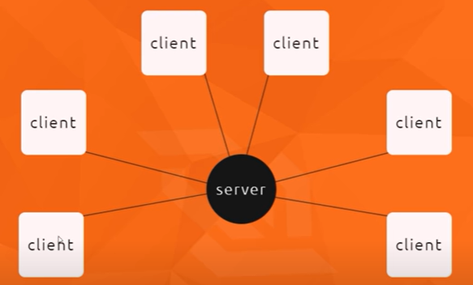
HTTPS Protocol
What problems we may encounter when using HTTPS protocol?
In some cases, we want the server to begin the data transfer, and not the client
(for example – a leaderboard in real-time applications).
In some cases, the importance of quick data
transfer (performance) is very important
(for example – live chat on a website).

Slide 5
HTTPS Protocol
How can we solve these problems?
There are many ways to deal with kinds of problems:
Polling – send request for new data every X amount of time.
Long Polling – send request to the server and keep the connection open until new data arrives.
Another solution that we are going to talk about is – Websockets.

Slide 6
Websockets
What is a Websocket?
A Websocket is a persistent connection between a Client and Server.
Websocket characteristics:
A bidirectional (2-way) communication channel.
It operates over HTTP through a single TCP/IP socket connection.
Headers are sent only once (in the initial handshake –will be explained later) – Improving performance and saving a lot of unnecessary data transfers and requests.
Easier to implement (than HTTPS).

Slide 7
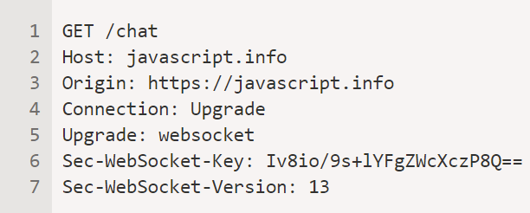
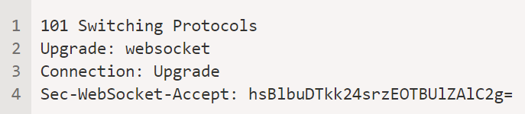
Websockets
How does Websocket works?
- When we want to use websockets, first the client send HTTP
request to server, asking “Hey server, let’s talk via websocket”?
Then, if the server agrees and return a “positive”
answer to that request (which is also HTTP), then the
websocket protocol created between the client and
the server.
That procedure is called – The initial handshake.

Slide 8
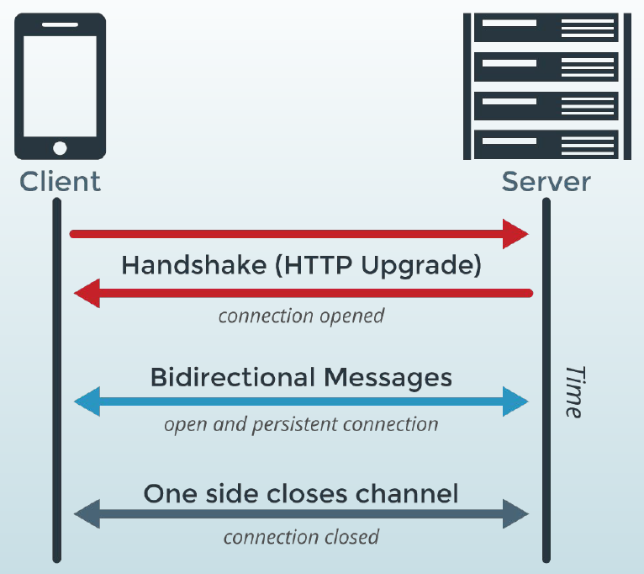
Websockets
- After the handshake, the socket is open between the
client and the Server and they can communicate in both
ways freely (No headers needed).
- All the request sent in the websocket are WS/WSS
(and not HTTP requests).
The websocket will be closed when one of the sides
(client/server) close the connection or when the
client/server just gone.

Slide 9
Websockets
What are the use-cases for websockets?
Web-based games.
Chatting applications.
In our case – Sending notifications to user in real-time
(real-time applications).

Slide 10
Websockets vs. HTTPS
HTTPS | Websockets
A unidirectional protocol. | A bidirectional communication protocol.
The connection between the Client and the Server closes after each HTTPS request. | The connection between the Client and the Server is closed only when one of them (Client/Server) terminates the connection.
Performance not as good as Websockets. | Better Performance (that HTTPS).
Sending unnecessary headers. | Sending only the needed data (without headers).
Can communicate with REST API. | Having trouble communicate with external REST API.

Slide 11
Websockets (Popular Problems & Solutions)
When navigating to a new URL address the websocket’s connection isn’t saved. How can we deal with this problem?
There are 2 solutions to this problem:
Maintaining single connection using “Single Page Application”.
Maintaining single connection using “Shared Web-Worker”.

Slide 12
Websockets (Popular Problems & Solutions)
Maintaining single connection using “Single Page Application”
All the communication appears only in one page, while GUI components updates whenever the server need to push information to the client or when the client need to push data to the server.
In other words, the new content would be loaded into the existing page, therefore the websocket won’t need to be reloaded.
Disadvantages using this solution:
GUI implementation becomes more complicated
(because you can’t just render a new page, you need to update each component instead).

Slide 13
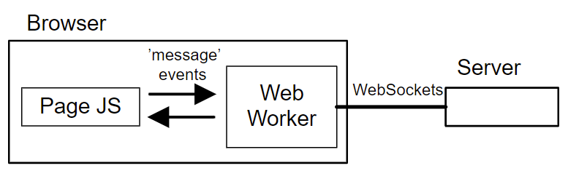
Websockets (Popular Problems & Solutions)
Maintaining single connection using “Shared Web-Worker”
The Shared Web-Worker is kind of thread-pool used when working with webpages.
It allows the JavaScript part of the page to be executed in a separate thread from the page’s main thread that runs the UI.
The main thread and the web-worker communicate by messages (events).
That way, the web-worker can be used for multiple pages with same websocket –
The websocket opens between the server and the web-worker and the web-worker messaging
the threads that handle the pages.
Disadvantages using Shared Web-Workers:
Not all the browsers support Shared
Web-Workers.

Slide 14
Websockets (in our workshop)
Why bidirectional communication is contradictory to our workshop’s architecture?
Our architecture is built in a way when one layer know only the layer underneath it
(for example - service layer knows business layer, but the business layer doesn’t know the service layer).
In other words, our architecture is one-way (unidirectional) communication.
Therefore, bidirectional communication (which is the way websockets works) between objects in our project might be a problem.

Slide 15
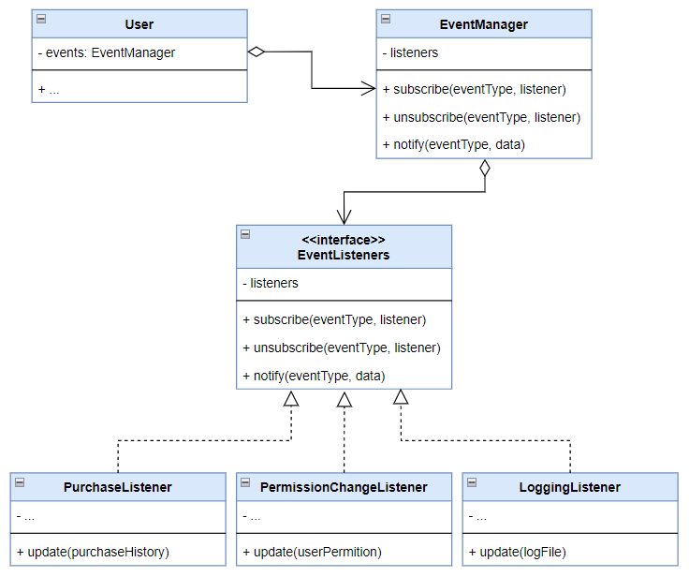
Websockets (in our workshop)
How can we solve this bidirectional communication problem?
We can use Observer design pattern in the
following way:
For each user in the system, we’ll do subscribe to
the relevant messages that he should get
(for example – store manager we’ll subscribe to
PurchaseListener event).
That way each user/client can send a message
(use the system) and get messages back according to
his subscriptions – which create bidirectional
communication as we wanted.

Slide 16
Websockets (in our workshop)
How can acceptance tests can support real-time notifications without depending on the web-worker component?
A solution to that can be creating a simple text file that will simulate the websockets
messages (or answers).
In that way, every time that our acceptance tests will require communication with websockets, the test will turn to the text file, and will get the answer of the websocket that should have been there.

